Slide 1
CS-301: Data Structures
TIME AND SPACE COMPLEXITY

Slide 2

Data Structures: A systematic way of organizing and accessing data.
--No single data structure works well for ALL purposes.
Output
Input
Algorithm
An algorithm is a step-by-step procedure for
solving a problem in a finite amount of time.

Slide 3
Algorithm Descriptions
Nature languages: Chinese, English, etc.
Pseudo-code: codes very close to computer languages, e.g., C, C++, Java programming languages.
Programs: C programs, C++ programs, Java programs, etc
Goal:
Allow a well-trained programmer to be able to implement.
Allow an expert to be able to analyze the running time.

Slide 4
An Example of an Algorithm
Algorithm sorting(X, n)
Input array X of n integers
Output array X sorted in a ascending order
for i ← 0 to n − 1 do
for j ← i+1 to n do
if (X[i]>X[j]) then
{ s=X[i];
X[i]=X[j];
X[j]=s;
}
return X

Slide 5
Analysis of Algorithms
Estimate the running time
Estimate the memory space required.
Depends on the input size.

Slide 6
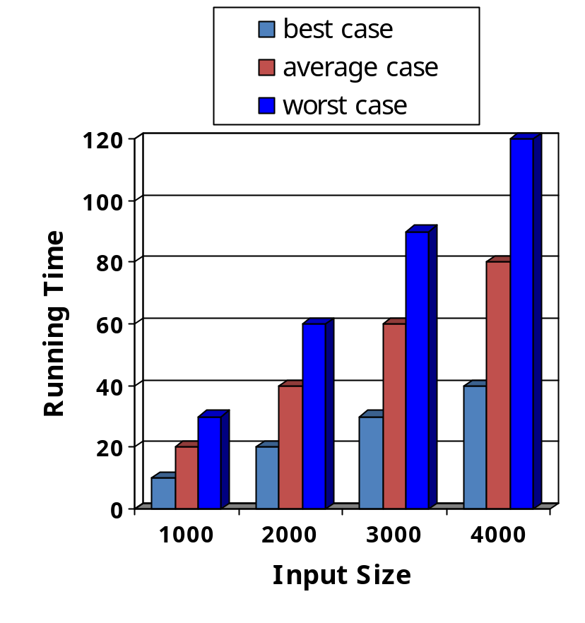
Running Time
Most algorithms transform input objects into output objects.
The running time of an algorithm typically grows with the input size.
Average case time is often difficult to determine.
We focus on the worst case running time.
  Easier to analyze
  Crucial to applications such as games, finance and robotics

Slide 7
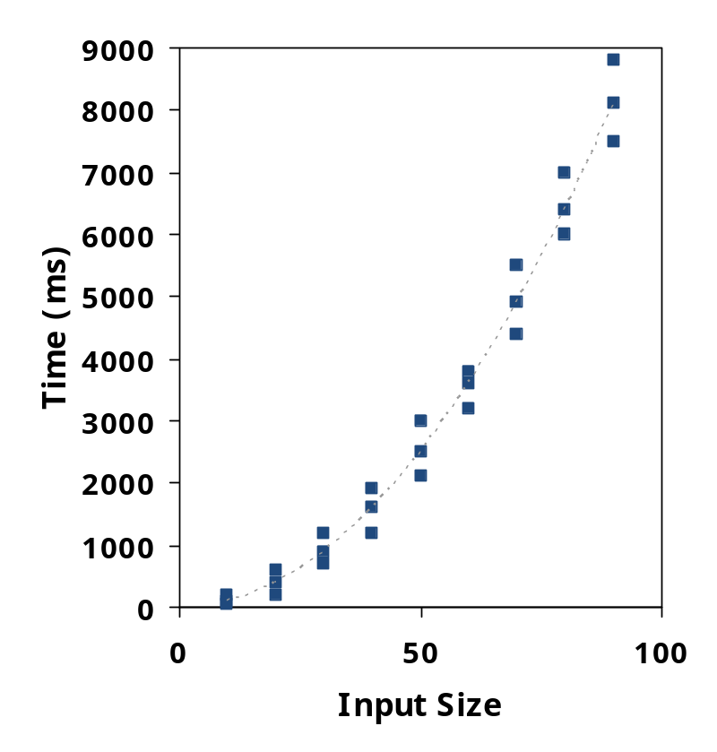
Experimental Studies
Write a program implementing the algorithm
Run the program with inputs of varying size and composition
Use a method like System.currentTimeMillis() to get an accurate measure of the actual running time
Plot the results

Slide 8
Limitations of Experiments
It is necessary to implement the algorithm, which may be difficult
Results may not be indicative of the running time on other inputs not included in the experiment.
In order to compare two algorithms, the same hardware and software environments must be used

Slide 9
Theoretical Analysis
Uses a high-level description of the algorithm instead of an implementation
Characterizes running time as a function of the input size, n.
Takes into account all possible inputs
Allows us to evaluate the speed of an algorithm independent of the hardware/software environment

Slide 10
Pseudocode
Example: find max element of an array
High-level description of an algorithm
More structured than English prose
Less detailed than a program
Preferred notation for describing algorithms
Hides program design issues
Algorithm arrayMax(A, n)
Input array A of n integers
Output maximum element of A
currentMax ← A[0]
for i ← 1 to n − 1 do
if A[i] > currentMax then
currentMax ← A[i]
return currentMax

Slide 11
Pseudocode Details
Control flow
  if … then … [else …]
  while … do …
  repeat … until …
  for … do …
  Indentation replaces braces
Method declaration
  Algorithm method (arg [, arg…])
  Input …
  Output …
Expressions
  Assignment
  (like = in C)
  Equality testing
  (like == in C)
  n² Superscripts and other mathematical formatting allowed

Slide 12
Primitive Operations
Basic computations performed by an algorithm
Identifiable in pseudocode
Largely independent from the programming language
Exact definition not important (we will see why later)
Assumed to take a constant amount of time in the RAM model
Examples:
  Evaluating an expression
  Assigning a value to a variable
  Indexing into an array
  Calling a method
  Returning from a method

Slide 13
Performance Analysis
Two criteria are used to judge algorithms: (i) time complexity (ii) space complexity.
Space Complexity of an algorithm is the amount of memory it needs to run to completion.
Time Complexity of an algorithm is the amount of CPU time it needs to run to completion.

Slide 14
Space Complexity
Memory space S(P) needed by a program P, consists of two components:
  A fixed part: needed for instruction space (byte code), simple variable space, constants space etc. → c
  A variable part: dependent on a particular instance of input and output data. → S_{p}(instance)
S(P) = c + S_{p}(instance)

Slide 15
Space Complexity: Example 1
Algorithm abc (a, b, c)
{
return a+b+b*c+(a+b-c)/(a+b)+4.0;
}
For every instance 3 computer words required to store variables: a, b, and c. Therefore S_{p}()= 3. S(P) = 3.

Slide 16
Space Complexity: Example 2
Algorithm Sum(a[], n)
{
s:= 0.0;
for i = 1 to n do
s := s + a[i];
return s;
}

Slide 17
Space Complexity: Example 2.
Every instance needs to store array a[] & n.
  Space needed to store n = 1 word.
  Space needed to store a[ ] = n floating point words (or at least n words)
  Space needed to store i and s = 2 words
S_{p}(n) = (n + 3). Hence S(P) = (n + 3).

Slide 18
Time Complexity
Time required T(P) to run a program P also consists of two components:
  A fixed part: compile time which is independent of the problem instance → c.
  A variable part: run time which depends on the problem instance → t_{p}(instance)
T(P) = c + t_{p}(instance)

Slide 19
Time Complexity
How to measure T(P)?
  Measure experimentally, using a “stop watch”
  → T(P) obtained in secs, msecs.
  Count program steps → T(P) obtained as a step count.
Fixed part is usually ignored; only the variable part t_{p}() is measured.

Slide 20
Time Complexity
What is a program step?
  a+b+b*c+(a+b)/(a-b) → one step;
  comments → zero steps;
  while (<expr>) do → step count equal to the number of times <expr> is executed.
  for i=<expr> to <expr1> do → step count equal to number of times <expr1> is checked.

Slide 21
Time Complexity: Example 1
 | Statements | S/E | Freq. | Total
1 | Algorithm Sum(a[],n) | 0 | - | 0
2 | { | 0 | - | 0
3 | S = 0.0; | 1 | 1 | 1
4 | for i=1 to n do | 1 | n+1 | n+1
5 | s = s+a[i]; | 1 | n | n
6 | return s; | 1 | 1 | 1
7 | } | 0 | - | 0
2n+3

Slide 22
Time Complexity: Example 2
 | Statements | S/E | Freq. | Total
1 | Algorithm Sum(a[],n,m) | 0 | - | 0
2 | { | 0 | - | 0
3 | for i=1 to n do; | 1 | n+1 | n+1
4 | for j=1 to m do | 1 | n(m+1) | n(m+1)
5 | s = s+a[i][j]; | 1 | nm | nm
6 | return s; | 1 | 1 | 1
7 | } | 0 | - | 0
2nm+2n+2

Slide 23
Performance Measurement
Which is better?
  T(P1) = (n+1) or T(P2) = (n² + 5).
  T(P1) = log (n² + 1)/n! or T(P2) = n^{n}(nlogn)/n².
Complex step count functions are difficult to compare.
For comparing, ‘rate of growth’ of time and space complexity functions is easy and sufficient.

